Slide 1


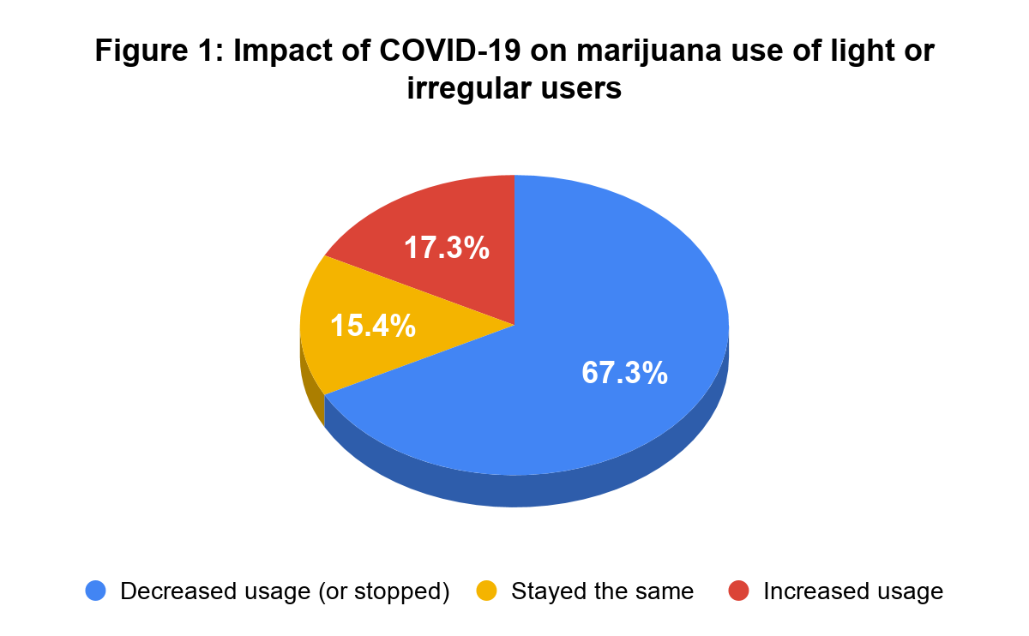
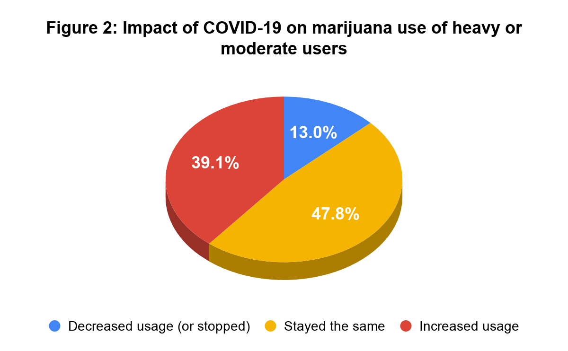
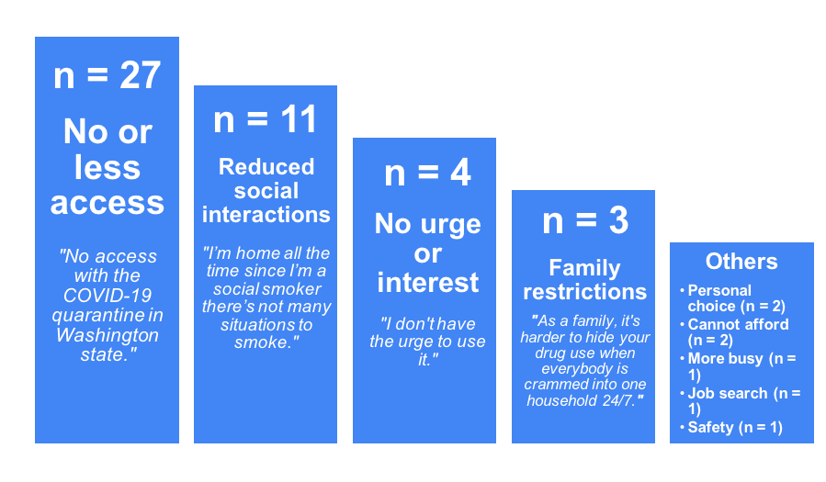
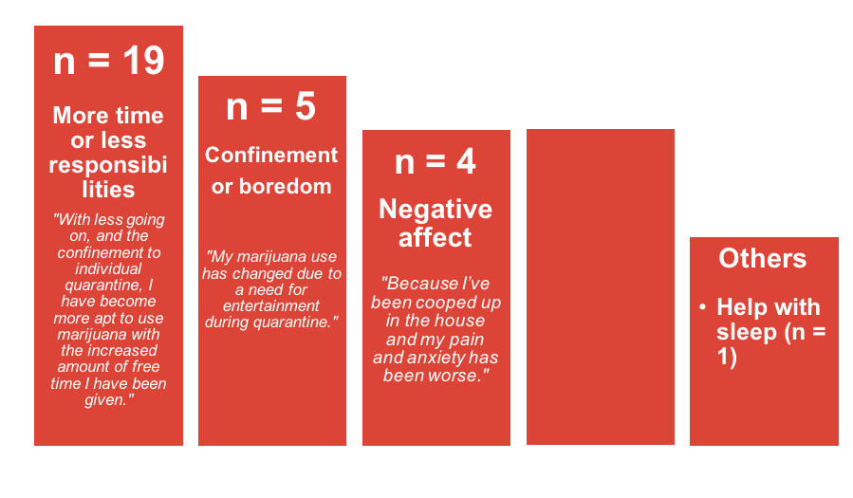
CHANGES IN LATE ADOLESCENT MARIJUANA USE DURING THE COVID-19 OUTBREAK VARY AS A FUNCTION OF TYPICAL USE
Li-Hui Chu, Elliot C. Wallace, Anna E. Jaffe, & Jason J. Ramirez
University of Washington, Center for the Study of Health and Risk Behaviors, Department of Psychiatry and Behavioral Sciences, Seattle, WA
INTRODUCTION
RESULTS
Adolescent marijuana use is a public health concern due to the initiation and escalation of use frequently reported during this developmental period.
On March 23, a stay-at-home order was issued that mandated all residents to remain indoors and practice social distancing. These restrictions have affected factors including marijuana access, parental supervision, amount of free time and stress levels that ultimately may impact marijuana usage amongst adolescents.
Previous research has indicated that substance abuse overall, including marijuana use, has increased compared to use before COVID-19 among university students (Gritsenko et al., 2020). Addiction related habits are also more likely to increase than decrease as a result of the pandemic (Rolland et al., 2020).
Although these initial studies have examined the effects of COVID-19 on substance use, changes in the level of marijuana use among adolescents are still unknown. In addition, the reasons behind these changes have yet to be examined.
The aims of the current analysis were:
  To understand how the novel coronavirus (COVID-19) has impacted marijuana usage amongst late adolescents in Washington state.
  To examine whether changes in marijuana use vary as a function of one’s typical levels of use.
In the sample, 55 participants reported never having tried marijuana, and none of these participants reported marijuana use after the COVID-19 outbreak.
As a result of COVID-19, 44 of 101 participants (who reported any prior marijuana use) reported stopping or decreasing their use, 30 reported using similar amounts as before and 27 reported increased marijuana use.
A chi-square test of independence revealed that changes in use significantly varied as a function of typical use, X² (2, N = 98) = 29.79, p < .001. The odds of irregular and light marijuana users decreasing their use was 13.73 times higher than moderate and heavy users. Moderate and heavy users had higher odds of maintaining their current use (5.04 times higher) and increasing their use (3.07 times higher) compared to irregular and light users during the COVID-19 outbreak.
METHODS
Figure 3: Reasons provided by participants for decreased use of marijuana during COVID-19
Participants and Procedures
Data described here were taken from a screening survey for a larger study examining adolescents’ implicit associations held in memory between marijuana and their own identities.
The screening survey consisted of items assessing demographic information and marijuana use. Items assessing how marijuana use has been impacted by COVID-19 were added to the survey beginning on April 2nd, 2020.
After April 2nd, the screening survey was completed by 156 late adolescents ranging in age from 14-19 (M_{age} = 17.0, SD_{age} = 1.1). Of these participants, 78% were biologically male, 76.3% identified as White/Caucasian, 22.4% as Asian/Asian American, 4.5% as Black/African American, 3.8% as Native Hawaiian/Pacific Islander, 5.1% as Other, and 11.5% as Latinx/Hispanic.
Measures
Typical Marijuana Use: Participants were first asked to describe their marijuana use by indicating if they were a light, moderate or heavy user, or have previously used marijuana but haven’t used recently (i.e., “irregular user”). For the purposes of chi-square testing, moderate and heavy users were collapsed into one group, while light and irregular users were collapsed into another group.
COVID-19 Impact on Use: Participants were then asked to respond to the question, “How has the novel coronavirus (COVID-19) impacted how much marijuana you’ve recently used?” by selecting one of the following statements: 1) I have never used marijuana, 2) I used similar amounts of marijuana as I typically do (no change), 3) I used more marijuana, 4) I used less marijuana, 5) I stopped using marijuana. Participants who had never used marijuana were excluded from later chi-square testing while using less marijuana and stopping marijuana use were combined into one response option.
Reasons for change: Participants were also asked to explain why their marijuana use had changed via an open ended response.
Figure 4: Reasons provided by participants for increased use of marijuana during COVID-19
n = 4
Increased or ease of access
“Gained very easy access.”
DISCUSSION
While the overall trend of marijuana use among these late adolescents appeared to decrease on average during this pandemic, this was not seen amongst moderate and heavy users who were more likely to maintain or increase their use compared to light and former users.
Findings in this study suggest that the primary reasons for decreasing marijuana use amongst adolescents include decreased availability and reduced social interactions. Primary reasons for increased marijuana use included more time or less responsibilities, boredom, negative affect such as increased stress and anxiety levels, and increased or ease of access.
Maintaining and finding healthy alternatives to deal with elevated stress and anxiety levels may be important preventative steps to help adolescents during these difficult times. Furthermore, it is recommended that adolescents seek appropriate mechanisms to help cope with the increased amount of free time that accompanies social distancing as the pandemic continues. Novel prevention and intervention strategies should take into account these important factors.
SELECTED REFERENCES
Gritsenko, V., Skugarevsky, O., Konstantinov, V., Khamenka, N., Marinova, T., Reznik, A., & Isralowitz, R. (2020). COVID 19 Fear, Stress, Anxiety, and Substance Use Among Russian and Belarusian University Students. International Journal of Mental Health and Addiction, 1–7. Advance online publication.
Rolland, B., Haesebaert, F., Elodie, Z., Amine, B., Haesebaert, J., & Franck, N. (2020). Global changes and factors of increase in caloric food, screen and substance use during the early COVID-19 containment phase in France: a general population online survey (Preprint).
Data collection and poster preparation were supported by R21DA045092 (PI: Ramirez) from the National Institute on Drug Abuse. Please send correspondence to Li-Hui Chu at lhc10@uw.edu

