Slide 1


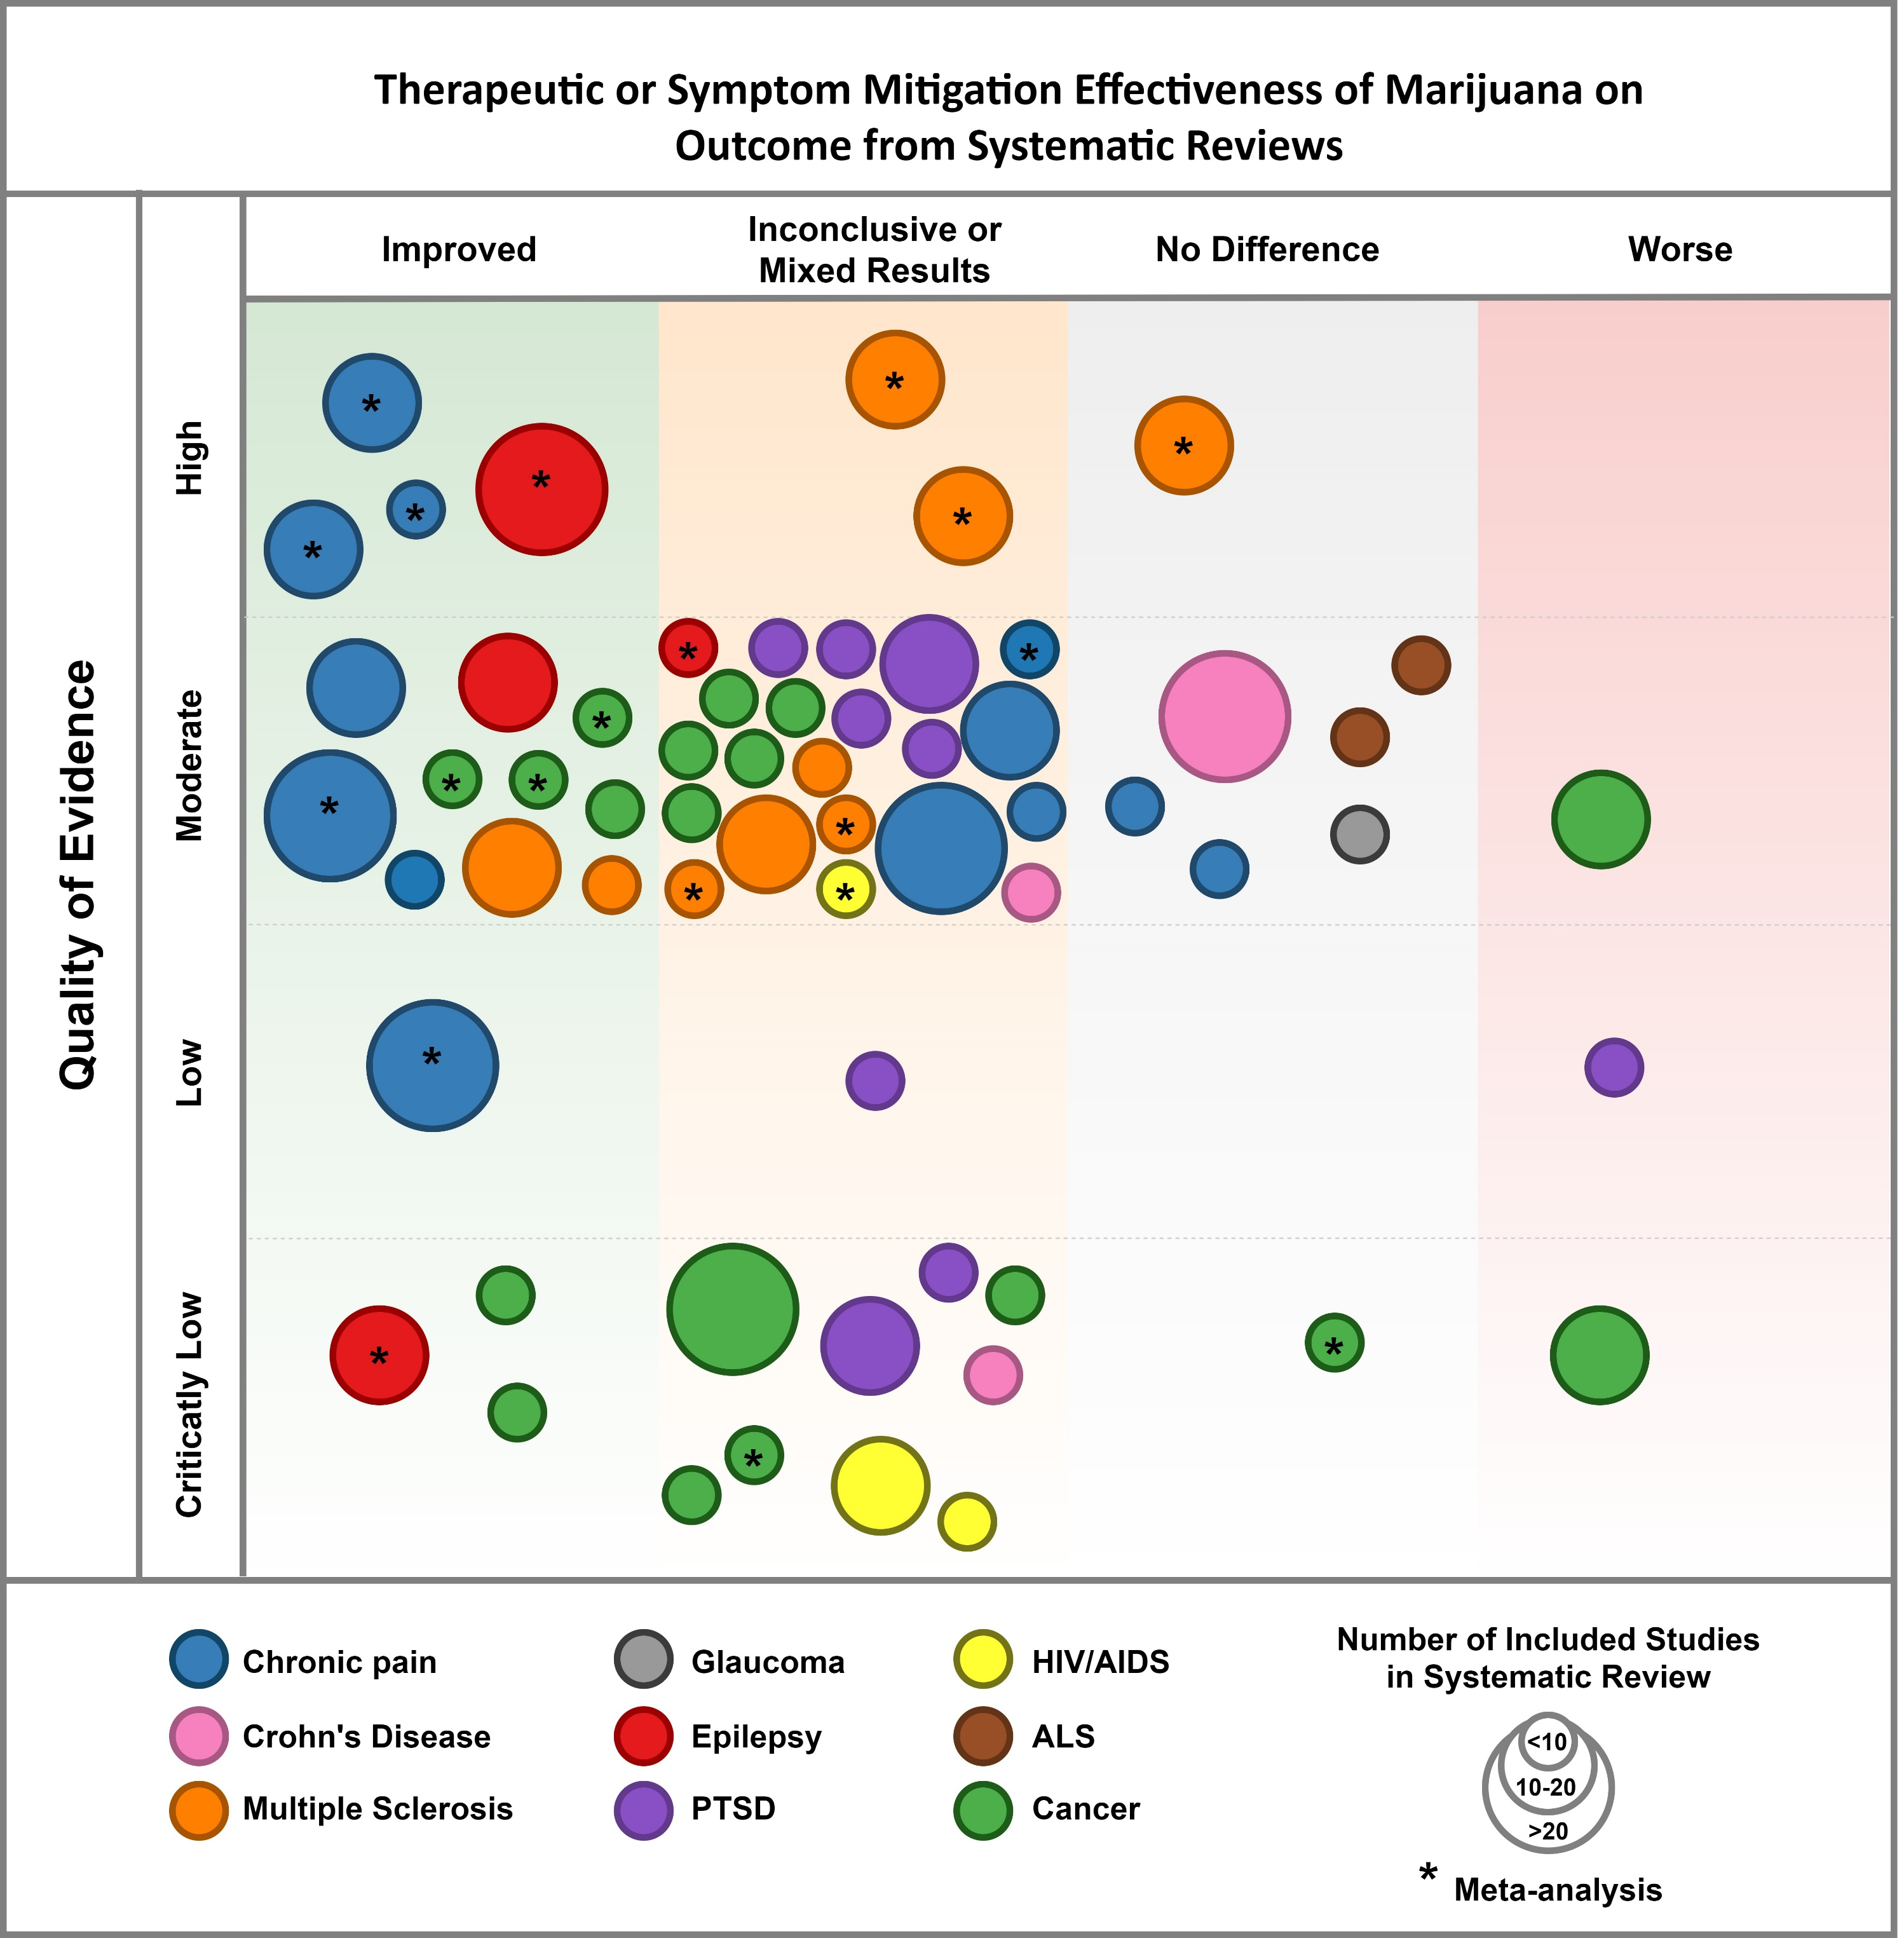


The body of evidence for medical cannabis requires more rigorous evaluation before consideration as a treatment option for many conditions
The evidence necessary to inform medical marijuana policy and treatment guidelines is currently insufficient for many conditions
A mapping literature review of medical cannabis clinical outcomes and quality of evidence in approved conditions in the United States from 2016 to 2019
Introduction
In two-thirds of the United States (U.S.) medical cannabis is available by physician order, but on the federal level cannabis remains illicit.
Qualifying medical conditions are typically defined on a state level and are required to permit the order of medical cannabis.
Objectives:
  To identify and map the most recently (2016-2019) published clinical and scientific literature across approved conditions for medical cannabis, and;
  To evaluate the quality of identified recent systematic reviews.
Methods
PubMed, Embase, Web of Science, Cochrane, and ClinicalTrials.gov were utilized to expand and update the National Academies of Sciences, Engineering, and Medicine´s (NASEM) comprehensive evidence review (included review of literature from 2000-2016) with search of literature from 2016-2019.[1]
Eleven clinical conditions were included (Table 1)
Exclusion criteria were: preclinical focus, non-English language, abstracts only, editorials /commentary, case studies/series, and non-U.S. study setting.
Two raters evaluated the quality of evidence of systematic reviews with or without meta-analysis by applying the AMSTAR-2 tool.[2] Additional raters resolved cases of evidence grade disagreement.
Results
15,917 studies were identified, and 438 studies were included after screening. More than two-thirds of all included studies were in the areas of cancer, chronic pain, and epilepsy (Table 1).
Few studies examined clinically relevant safety and effectiveness outcomes (Table 2).
Safety and effectiveness outcomes differed by indication (Figure 1, Table 2).
Few high-quality systematic reviews are available, except within MS, epilepsy, and chronic pain (Figure 1).
Condition | Total | SRMA | SR | RCT | OS/QE | Other reviews
ALS | 9 | 2 | - | - | 2 | 5
Autism | 17 | 1 | - | - | 8 | 8
Cancer | 139 | 6 | 12 | 4 | 31 | 86
Chronic Pain | 120 | 8 | 8 | 3 | 36 | 63
Crohn’s | 25 | - | 2 | 1 | 8 | 14
Epilepsy | 77 | 3 | 2 | 4 | 24 | 44
Glaucoma | 14 | - | 1 | - | - | 12
HIV/AIDS | 25 | 3 | - | - | 19 | 3
MS | 25 | 5 | 4 | - | - | 16
Parkinson’s | 17 | - | - | 1 | 4 | 12
PTSD | 50 | - | 10 | 5 | 3 | 31
Table 1: Design type of all reviewed studies, by medical condition
Abbreviations: SRMA=Systematic review with meta-analysis; SR=Systematic review without meta-analysis; RCT=Randomized controlled trial; OS/QE=Observational/ quasi-experimental study; ALS=Amyotrophic Lateral Sclerosis; MS=Multiple Sclerosis.
References
National Academies of Sciences, Engineering, and Medicine 2017. The Health Effects of Cannabis and Cannabinoids: The Current State of Evidence and Recommendations for Research.
Shea et al. AMSTAR 2: a critical appraisal tool for systematic reviews that include randomized or non-randomized studies of healthcare interventions, or both. BMJ. 2017;358:j4008
Figure 1: Quality of evidence among systematic reviews assessing cannabis efficacy and safety outcomes
Authors
Sebastian Jugl, BPharm, RPh; Aimalohi Okpeku, BPharm; Brianna Costales, BS; Earl J. Morris, PharmD, MPH;
Golnoosh Alipour-Harris, PharmD;
Juan M. Hincapie-Castillo, PharmD, PhD;
Nichole E. Stetten, PhD, MPH, CPH;
Ruba Sajdeya, MD; Shailina Keshwani, BPharm;
Verlin Joseph, MPH; Yahan Zhang, MS; Yun Shen, MPH; Lauren Adkins, MLIS; Amie Goodin, PhD, MPP.
University of Florida
Table 2: Effectiveness and safety outcomes of eligible reviewed studies (RCTs, QEs, and OS)
Condition | Effectiveness Outcome Change |  |  |  |  | Safety Outcome Change
 | Total | Improvement | Worsening | No change | Other | Total | No change | Worsening | Other
Autism | 3 | 2 | - | 1 | - | - | - | - | -
Cancer | 3 | 1 | - | 2 | - | 4 | - | 4 | -
Chronic Pain | 3 | 2 | - | 1 | - | - | - | - | -
Crohn’s | 2 | 1 | - | - | 1 | 1 | - | 1 | -
Epilepsy | 14 | 9 | - | 3 | 2 | 17 | 5 | 6 | 3
HIV/AIDS | 4 | - | 2 | 2 | - | 4 | 2 | 2 | -
Parkinson’s | - | - | - | - | - | 1 | 1 | - | -
* Contact corresponding author
s.jugl@ufl.edu
Contact the Consortium
mmj.outcomes@cop.ufl.edu
https://mmjoutcomes.org/

